Slide 1


SAP UI5 & FIORI with OData TRAINING
Anubhav Oberoy & Nishan Nainsukha
Day – 3

Slide 2

Agenda – Day 3
--Cascading Style Sheet--
What is CSS & Why we use CSS
Understanding the Ways of Applying CSS
1. Inline CSS
2. Internal CSS
Understanding the BOX Model
--JavaScript-
Introduction to JavaScript
Some Important Points about JavaScript
Understanding the Syntax of JavaScript
JavaScript Coding Conventions
Understanding the naming convention in JS
Describing the Ways of JS
Types of JavaScript
Introduction to Console

Slide 3

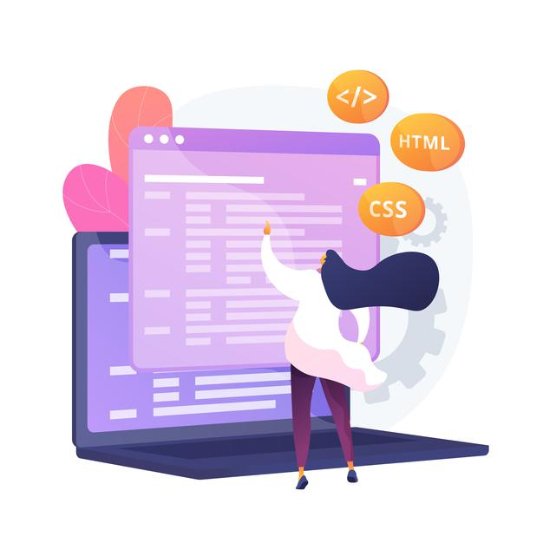
Introduction to CSS
CSS Stands for Cascading Style Sheets
CSS describes how HTML elements are to be displayed on screen, paper, or in other media.
CSS saves a lot of work. It can control the layout of multiple web pages all at once.
External stylesheet are stored in CSS file.
We need CSS because HTML can only generate static content w/o coloring, formatting, borders, beautification.
Ways of applying CSS in an HTML :-
01 Inline CSS
02 Internal CSS
03 External CSS
In Inline Style CSS is applied along with HTML Element
In Internal type the CSS is applied at the Page level
In External type the a separate CSS file is created and linked to the Page

Slide 4
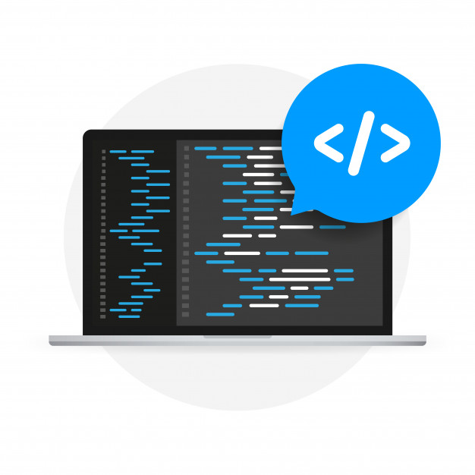
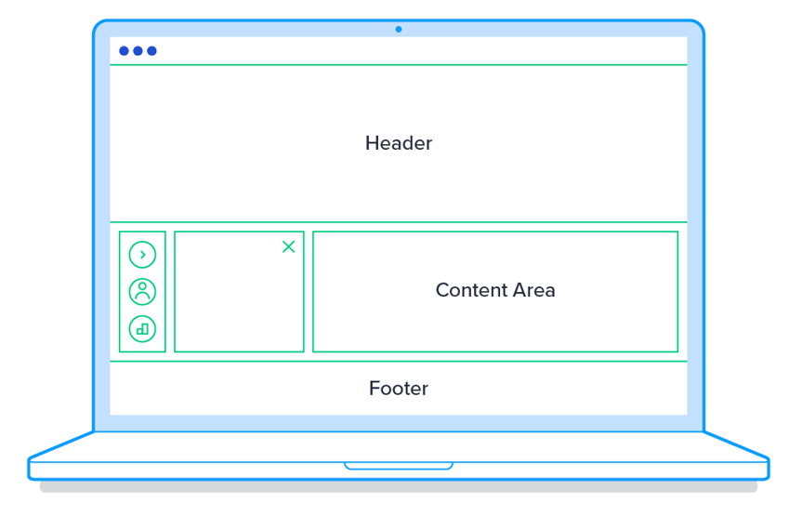
Why Use CSS
CSS helps we to keep the informational content of a document separate from the details of how to display it
The details of how to display the document are known as its style.
We keep the style separate from the content so that you can:
Avoid duplication
Make maintenance easier
Use the same content with different styles for different purposes
In general, you use HTML to describe the content of the document, not its style; you use CSS to specify its style, not its content.

Slide 5


Inline CSS
Inline CSS: Inline CSS contains the CSS property in the body section attached with element is known as inline CSS. This kind of style is specified within an HTML tag using the style attribute.
We use a style attribute to assign CSS styling properties.
Inline styles in CSS could be useful for previewing changes instantly or adding CSS rules to only one or two elements. When you don't have access to your .css file, knowing how inline style CSS works can be convenient.
The following example sets the text color of the <h3> element to brown:
<div class="box-title">
<h3 style="color: brown;">What is HTML?</h3>
</div>
CSS Colors, Fonts and Sizes
The CSS color property defines the text color to be used
The CSS font-family property defines the font to be used.
The CSS font-size property defines the text size to be used.
Exercise code link for inline CSS:
index.html
Image

Slide 6
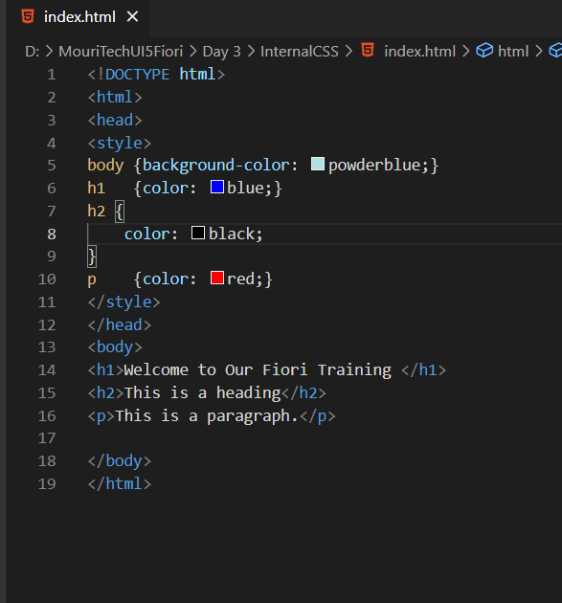
Internal CSS
Internal or Embedded CSS: This can be used when a single HTML document must be styled uniquely. The CSS rule set should be within the HTML file in the head section i.e. the CSS is embedded within the HTML file.
A Internal style sheet may be used if one single page has a unique style
Internal Style sheet are created using <style> element, which is added inside the <head> element of the HTML document.
You can define any number of <style> elements in an HTML document but they must appear between the <head> and </head> tags.
<style>
selector {
propertyname: value;
propname: value;
}
</style>
Exercise code link for internal CSS:
index.html

Slide 7
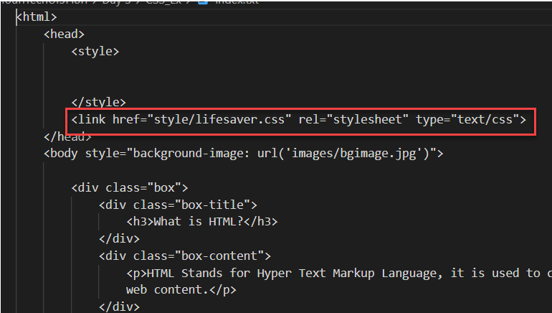
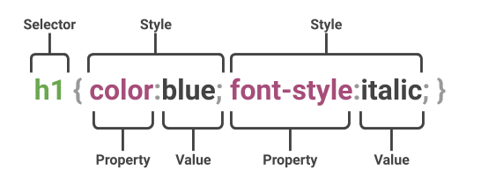
External CSS
External CSS: External CSS contains separate CSS file which contains only style property with the help of tag attributes (For example class, id, heading, … etc). CSS property written in a separate file with .css extension and should be linked to the HTML document using link tag. This means that for each element, style can be set only once and that will be applied across web pages.
You can attach external style sheets in two ways — linking and importing.
Define style sheet rules in a separate .css file and then include that file in your HTML document using HTML <link> tag.
Before linking, we need to create a style sheet first. Let's open your favorite code editor and create a new file. Now type the following CSS code inside this file and save it as "style.css".
An external style sheet can be linked to an HTML document using the <link> tag. The <link> tag goes inside the <head> section.

Slide 8

Box Model in CSS
In CSS, the term "box model" is used when talking about design and layout.
All HTML elements can be considered as boxes.
The CSS box model is essentially a box that wraps around every HTML element. It consists of: margins, borders, padding, and the actual content. The image below illustrates the box model:
1
Content: The Content of the box, where text and images appear
Explanation of the different parts
2
Padding: Clears an area around the content. Padding is transparent.
3
Border: A border that goes around the padding and content.
4
Margin: Clears an area outside the border. The margin is transparent.
Exercise code links Code for External CSS
index.html
style.css

Slide 9
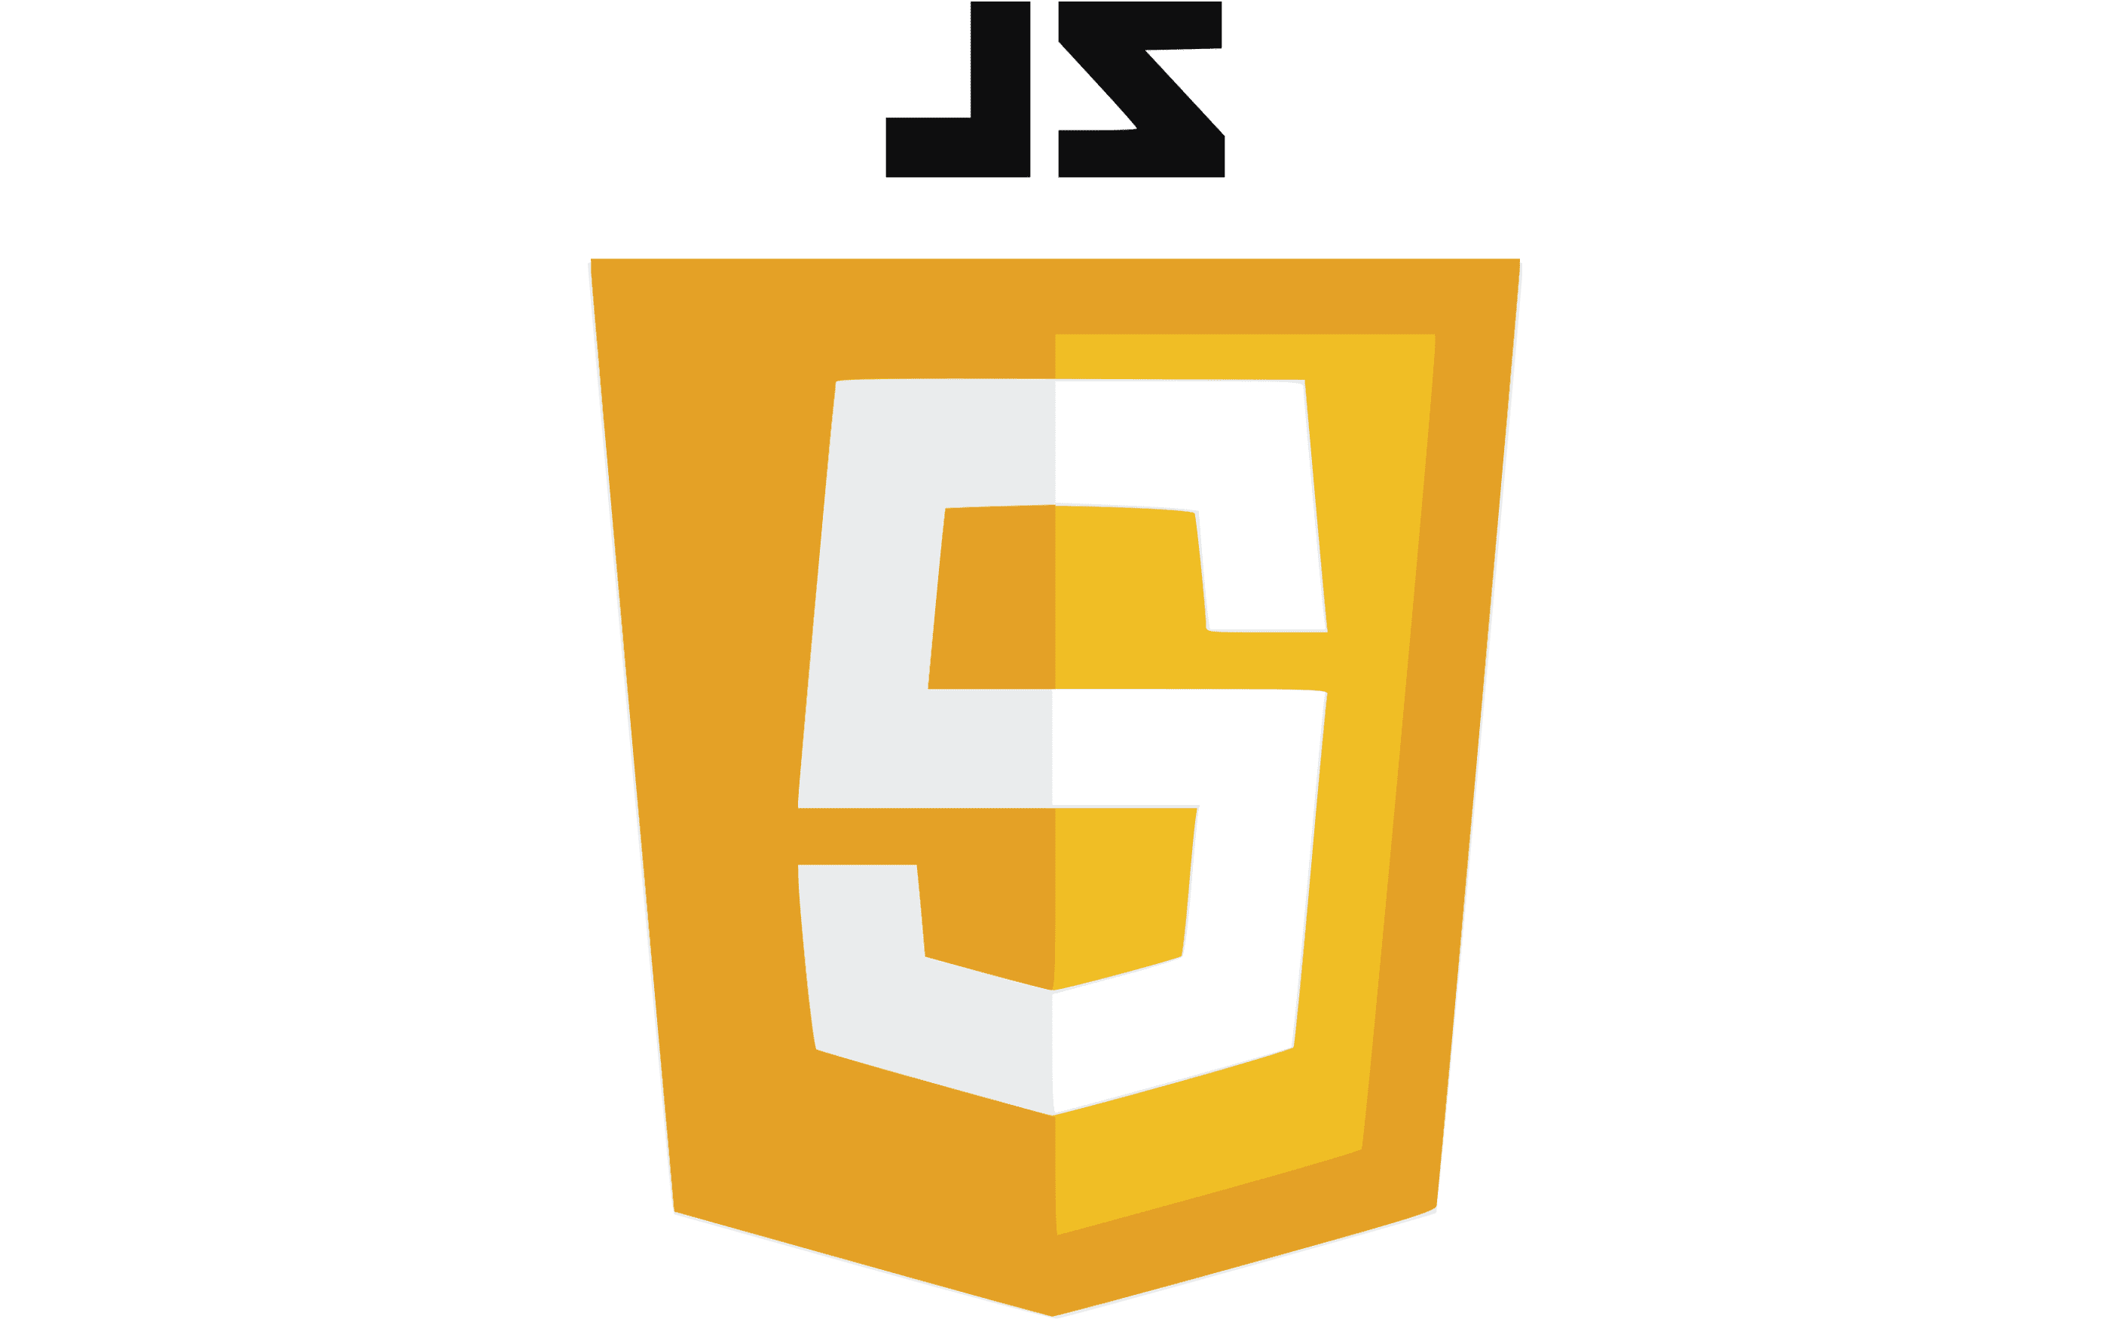
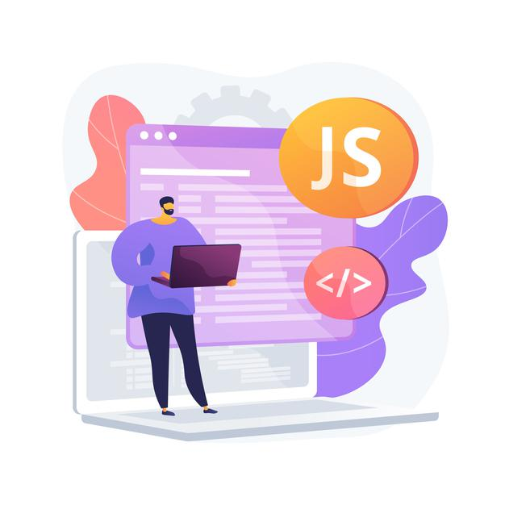
JavaScript
JavaScript is the programming language of the Web.
JavaScript is the world's most popular programming language.
It is an asynchronous non-blocking IO language.
JavaScript is a text-based programming language used both on the client-side and server-side that allows you to make web pages interactive.
Client-side JS – When code runs on Browser.
Server-side JS – When the code runs on webserver, e.g. NodeJS
Where HTML and CSS are languages that give structure and style to web pages, JavaScript gives web pages interactive elements that engage a user.
Types of function in JavaScript
There are 2 type of functions in JS
Anonymous Function – a function without name
Syntax: function(p1, p2 ) {
--code--
}
Named Function – a function with a name
Syntax:- function functionName(p1, p2) {
--code—
}

Slide 10
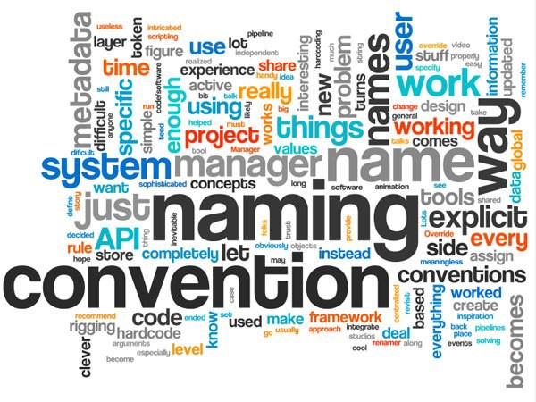

JavaScript Coding Convention
Coding conventions are style guidelines for programming.
All names start with a letter. firstName="John";
JavaScript variables are case sensitive.
A JavaScript variable should be self-descriptive.
All other whitespace characters in string literals are escaped, and Tab characters are not used for indentation.
File names must be all lowercase and may include underscores (_) or dashes (-), but no additional punctuation. Follow the convention that your project uses. Filenames’ extension must be .js.
Always end a simple statement with a semicolon.
General rules for complex (compound) statements:
Put the opening bracket at the end of the first line.
Use one space before the opening bracket.
Put the closing bracket on a new line, without leading spaces.
Do not end a complex statement with a semicolon.
function myFirstDemoFunction() {
alert('welcome to inline js');
}

Slide 11

Some Important points of JavaScript
How to apply JavaScript
There are 3 ways of applying JavaScript on a page:
Inline JS :- It is applied at the element level. It cannot be reused.
Syntax:-
<tagname eventname=“code”></tagname>
Internal JS :- It is applied at the page level inside a special tag named <script> tag. We can write multiple functions in script tag.
External JS :- We move our code to an external file with extension .js or .ts and reuse the same using <script src=“”>
Debugging Shortcuts in Browser
F10 – step over – F6
F11 – Step inside – F5
Shift + F11 – Step out – F7
F8 – continue till next BP – F8
F5 – Whole page refresh

Slide 12
Types of JavaScript
Client Side
Server Side
Server Side JavaScript (SSJS) is an extended version of JavaScript that enables back-end access to databases, file systems, and servers.
Server side JavaScript, is javascript code running over a server local resources , it's just like C# or Java, but the syntax is based on JavaScript. A good example of this is Node.JS , with Node.JS you write JavaScript to program on the server side, and that code can be seen as normal C#, C, or any other server side language code.
Client-side JavaScript is the most common form of the language. The script should be included in or referenced by an HTML document for the code to be interpreted by the browser.
It means that a web page need not be a static HTML, but can include programs that interact with the user, control the browser, and dynamically create HTML content.
Insert your desired text here.
Insert your desired text here.
Insert your desired text here.
Insert your desired text here.

Slide 13

Exercise
In this exercise we will use JavaScript.
Adding some Input fields, Label and Buttons.
Exercise Code
index.html
reuse.js
Style.css

Slide 14
Introduction to Console
Code Debugging
Programming code might contain syntax errors, or logical errors.
Many of these errors are difficult to diagnose.
Often, when programming code contains errors, nothing will happen. There are no error messages, and you will get no indications where to search for errors.
Searching for (and fixing) errors in programming code is called code debugging.
JavaScript Debuggers
Debugging is not easy. But fortunately, all modern browsers have a built-in JavaScript debugger.
Built-in debuggers can be turned on and off, forcing errors to be reported to the user.
With a debugger, you can also set breakpoints (places where code execution can be stopped), and examine variables while the code is executing.
Normally, otherwise follow the steps at the bottom of this page, you activate debugging in your browser with the F12 key, and select "Console" in the debugger menu.
The debugger Keyword
The debugger keyword stops the execution of JavaScript, and calls (if available) the debugging function.
This has the same function as setting a breakpoint in the debugger.

Slide 15

End of Day 3

Slide 16

Questions

Slide 17

Anubhav Oberoy

Slide 18


We’re committed to empower you to be
Most Desirable Resource
through powerful training solutions.
We build the workforce of the future.
250+
Corporate Clients
30,000+
Learners Trained
25000+
Learners Placed
FREE WEBINARS
Sign up for free webinars with industry experts every fortnight!
Enroll Now!
Contact us today!
https://anubhavtrainings.com/

Slide 19




More from AnubhavTrainings.com

Slide 20
Title
Content

